Slide 1
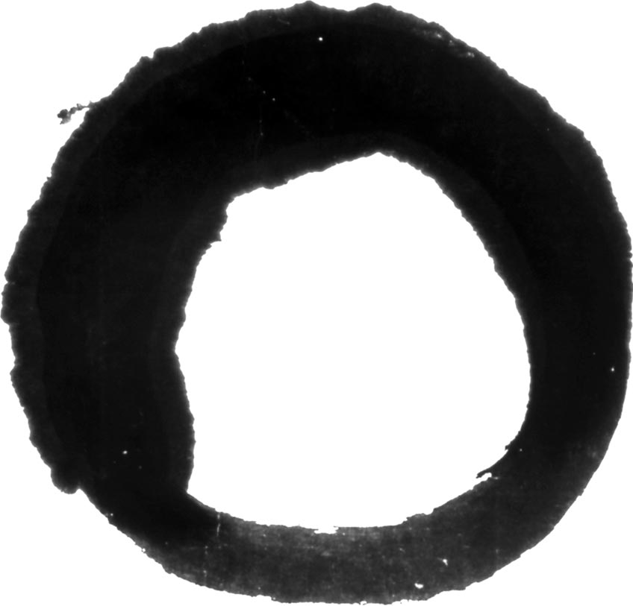
Zen Artworks

Slide 2
In Zen Buddhism, the circle is a symbol of infinity that is both empty and full. Painting a circle, or enso, is a meditation practice. Though it looks simple, to make a truly round stroke of ink with a brush where the end smoothly connects with the beginning takes practice.
Zen circle (enso) Artist: Tengan Chibon (Japanese, 1737 - 1805) Ink on paper
Gift from The Collection of George Gund III 2016.138

Slide 3
This calligraphy is written entirely in Chinese characters by a Japanese Zen master. The text details what is today known as a "dharma combat” or Zen dialogue, which occurred between the Chinese Chan (Zen) master Yunmen Kuangzhen (864–948) and a disciple. This kind of dialogue would have been studied by Zen monks in training. In a tearoom it also stimulates discussion and imbues the gathering with a thoughtful atmosphere and Zen aesthetic.
Calligraphy of a Zen dialogue from The Record of Yunmen
Artist: Seigan Sōi (Japanese, 1588 - 1661) approx. 1588-1611, Momoyama period (1573-1615)
Ink on paper, Museum purchase, City Arts Trust Fund with additional funding from Mr. and Mrs. Johnson S. Bogart and Mr. and Mrs. Willard G. Clark, 1989.3

