Slide 1
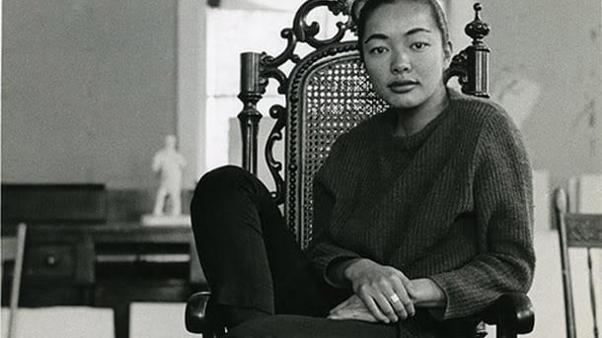
Bernice Bing – Art Works
Bernice Bing, promotional image for “Divided Attentions: The Worlds of Bernice Bing”

Slide 2
March ’86, 1986, Bernice Bing, Monoprint. Courtesy of the Calabi Gallery

Slide 3
Velasquez Family, 1961, Bernice Bing, oil on canvas. Photograph courtesy of the Crocker Museum

Slide 4
Mayacamas No. 6, March 12, 1963, Bernice Bing. Photograph © Randy Dodson

Slide 5
Vital Energy, 1986, Bernice Bing, oil on canvas, 66’ x 48’. Sonoma Valley Museum of Art

Slide 6
A Lady and a Road Map, 1963, Bernice Bing, oil on canvas, 68” by 52”. Estate of Bernice Bing

Slide 7
Big Sur, 1967, Bernice Bing, acrylic, 32” x 32”, Sonoma Valley Museum of Art

